Slide 1

Investment Team
Boeing Co (NYSE: BA)
Industrials & Consumers
April 2024
Research Team
Industrials & Consumers
This presentation is for informational purposes only and is not an offer to buy or sell or a solicitation to buy or sell any securities, investment products or other financial product or service, or an official confirmation of any transaction.

Slide 2
1
4
Table of Contents
Company Overview
Valuation
1. Company Overview
9. Historical Share Price Performance
2. Business Model
10. Valuation Overview Incl. Football Field
3. Operating Forecast
11. Valuation Analysis
4. Shareholder Ownership
12. Comparables Overview
2
5
Industry Overview
Catalysts and Risks
5. Competitive Environment
13. Risk Considerations
6. Key Industry Trends
14. The Four W’s
7. Corporate Finance Activity
3
6
Investment Thesis
Recommendation
8. Rationale
15. Optimal Price Analysis

Slide 3

Agenda
1
Company Overview
2
Industry Overview
3
Investment Thesis
4
Valuation
5
Catalysts and Risks
6
Recommendation

Slide 4
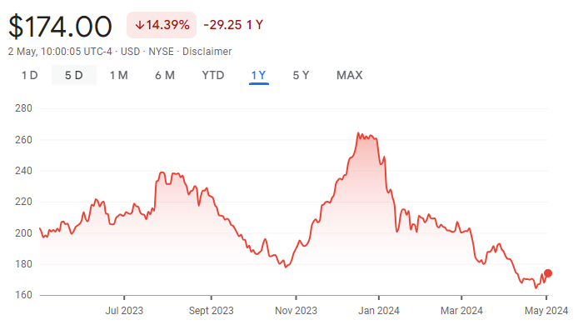
Company Overview
Company Highlights
Valuation & Share Performance
History: Boeing was established in 1916 by William Boeing and George Westervelt. Some key milestones in the company's history include the first flight of the B-17 in 1935, the introduction of the 747 in 1970, and the launch of the Dreamliner 787 in 2009.
Valuation: Boeing's stock performance has fluctuated due to industry trends and company-specific events. The market factors in order backlogs, new aircraft launches, and defense contracts. Key investment highlights are Boeing's diverse portfolio, innovation, and global client relationships.
Strategy: Boeing is focusing on safety, innovation, and efficiency. The company's strategy emphasizes new technologies, operational excellence, and expanding its global presence, with strong management commitment to delivering high-quality products.
Corporate Finance Transactions: Boeing's recent notable acquisitions include Aurora Flight Sciences and KLX Aerospace Solutions.
Ownership: The top shareholders are Vanguard Group (7.90%) and BlackRock (5.97%).
Key Valuation Statistics
Enterprise Value | $143bn | Revenue (FY23) | $77.8bn
Market Cap | $105bn | EBITDA (FY23) | $1.1bn
P/E | N/A | EBITDA Margin ‘23 | 1.40%
EV/EBITDA | 46.50x | Debt / EV | 0.34
Cash | $7.5bn | Total Debt | $47.9bn
Industry Data | Average
Commercial Airplanes
EV/EBITDA -122.167 | 55.837
EV/Revenue - 3.967 | 2.392
P/E - 22.163 | 29.004
Defense, Space & Security
EV/EBITDA - 92.594 | -482.399
EV/Revenue - 5.527 | 9.831
P/E -12.506 | 994.763
Revenue Mix | % | Gross ($mm)
Commercial Airplanes | 43.5% | $33,901.0
Defense, Space & Sec.. | 32.0% | $24,933.0
Glbl. Service & Support | 24.5% | $19,127.0
Share Price | Current: $174.00 | High/Low: $168.65 / $164.93
Key Metrics | Unit
Gross Margin | 9.93
ROIC | -4.50
Debt to Equity | -2.818
Cash ratio | 0.17
ROA | -1.62
Pretax Margin | -2.58

Slide 5
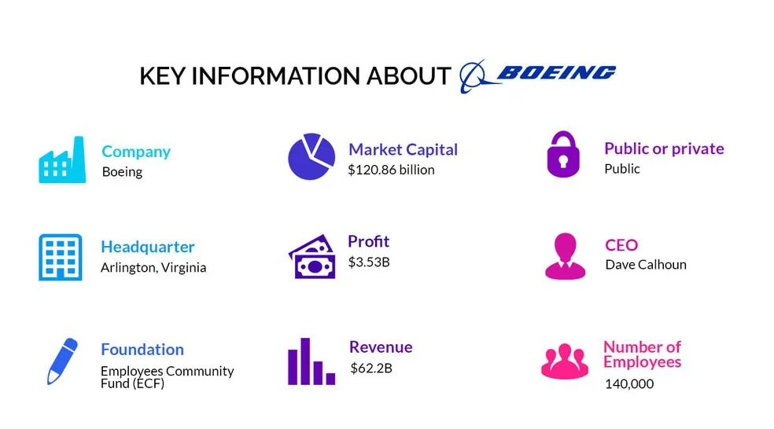





Boeing Business Model
Operating Segments
Key Figures as of May 2023
Boeing generates revenues by designing, developing, manufacturing commercial jetliners, military aircrafts, satellites, missile defense, human space flight and launch systems and services.
It has mainly 3 operating segments:
Commercial Airplanes: Makes and sells commercial jet aircraft and provides fleet support services, principally to the commercial airline industry and to individuals.
Defense, Space & Security Systems: Engages R&D, production and modification of manned and unmanned military aircraft and weapons systems.
Global Services: This segment provides services to Boeing's commercial and defense customers worldwide.
Competitors

Slide 6
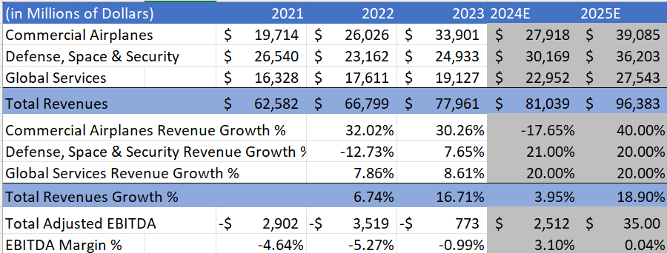
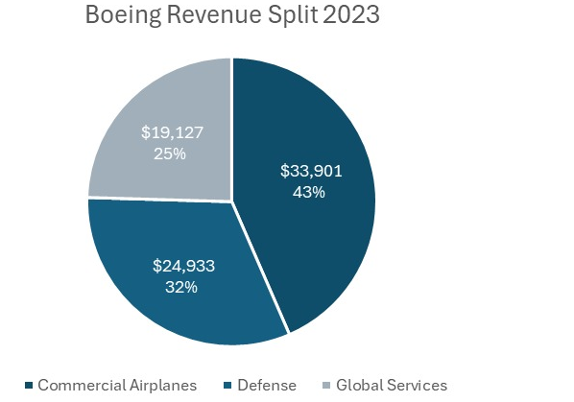
Operating Forecast
Revenue Drivers
Revenue & EBITDA Forecast
EXAMPLE
Commercial Airplanes: First Quarter revenue of $4.7 billion and operating margin of (24.6) percent primarily reflect lower 737 deliveries and 737-9
grounding customer considerations
Even after the FAA audit on the 737, it managed to secure 125 net orders in 2024 Q1.
There exists a Backlog of $448 Billion, suggesting a positive free cash flow for 2024
Defense and Space: Awarded 17 P-8 aircraft for Canada and Germany, Secured final contract from the U.S. Navy for 17 F/A-18 production aircraft
Q1 2024 was another quarter of sequential improvement. Backlog grew to $61 Billion
Management plans to increase margins to high single digits by 2025 assuming a forecasted growth rate of 20%
Global Services: Q1 2024 was another strong quarter for this segment with a strong operating margin of 18.2%
Boeing opened another maintenance facility in Jacksonville, Florida, to support military customers

Slide 7
Shareholder Ownership Analysis
Ownership Analysis
Boeing's ownership structure reveals a significant concentration of institutional investors, with major players like Vanguard Group and BlackRock leading the pack. The high percentage of institutional shareholders indicates stability, with a long-term holding pattern, suggesting that float turnover is relatively low. Insiders, including executives and board members, also hold shares, but to a lesser extent. Retail investors account for a smaller share.

Slide 8
Agenda
1
Company Overview
2
Industry Overview
3
Investment Thesis
4
Valuation
5
Catalysts and Risks
6
Recommendation

Slide 9




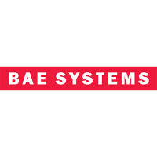

Competitive Landscape
Company | EV/ LTM Sales | EV/ LTM EBITDA | Strategy | Structure
 | EV/Sales: 1,81 P/E: 28,54 | EV/Revenue: 1.72 EV/EBITDA: 14.33 | Airbus recently increased production rates for A320 family to meet high demand. They also focus on developing hydrogen-powered aircraft. Analysts see strong commercial business but are cautious on the defense sector. Their growth strategy consist around the exploration of new technologies like electric and hydrogen propulsion. Airbus is a direct competitor across commercial aircraft, defense & space sectors. | Commercial Aircraft, Defense and space technology, Helicopters Airbus 72%, Airbus defense and space 17% , airbus helicopters 11%
 | EV/Sales: 1,69 P/E: 16,51 | EV/Revenue: 1.86 EV/EBITDA: 11.71 | Lockheed Martin is a major defense player, recently winning a big F-35 contract and developing hypersonic weapons. Analysts are bullish due to rising defense spending and the F-35 program. Their focus is on core defense and benefits from geopolitical tensions. They are competitor in defense & space sector but not commercial aircraft. | Aeronautics, Missiles and Fire Control, Rotary and Mission systems, Space Aeronautics 40%, Rotary and mission systems 26%, space 18%, missile and fire control 16%
 | EV/Sales: 1,85 P/E: 15,39 | EV/Revenue: 2.17 EV/EBITDA: 11.20 | Northrop Grumman is another defense giant, recently awarded the B-21 bomber program. They also make headway in drones. Analysts are positive on their growth potential, particularly in the B-21 program. They focus on core defense and expanding in autonomous tech and space. They are competitors in defense & space sector. | Aerospace systems, Mission systems, Technology services, Innovation Systems Space systems 34%, missions' systems 27%, aeronautics systems 26%, defense systems 13%,
 | EV/Sales: 1,62 P/E: 18,81 | EV/Revenue: 1.74 EV/EBITDA: 13.59 | BAE Systems (merged with Raytheon) is a powerhouse in defense & aerospace. Analysts are optimistic regarding the recent merger and their competitive edge. Their plan is to focus on consolidation in defense and expanding into cyber security. They are competitors in defense & space sector. | Electronic systems, Cybersecurity, Industrial manufacturing, Maritime Air 28%, Electronic systems 23%, maritime 23%, plateform & services 16%, cybersecurity & intelligence 10%
 | EV/Sales: 1,73 P/E: 21,69 | EV/Revenue: 1.94 EV/EBITDA: 15.02 | General Dynamics balances business jets with its core defense business. They're investing in AI for military applications, with analysts mostly holding due to the solid performance in business jets but some uncertainty in defense. They compete with Boeing in business jets but not large commercial aircraft. | Aerospace, Combat systems, IT, Marine systems Technologies 30%, marine systems 29%, aerospace 21%; combat systems 20%

Slide 10
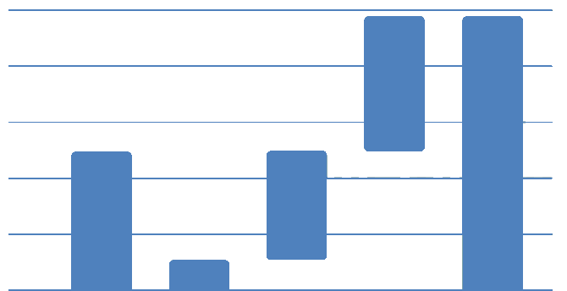
Resilience Amid Challenges: Industry Performance & Recovery
Despite macro-economic challenges, the aviation industry demonstrated resilience, with strong performance driven by pent-up demand. Industry-wide revenue passenger-kilometres (RPKs) reached 87.8% of the 2019 level, and cargo remained a significant revenue contributor.
Key Figures
Global Outlook 2023-2042: Global fleet will double, nearly half of deliveries for replacement
50K
40K
30K
20K
10K
0
2022 Fleet
Retained Fleet
Replacement
Growth
2042 Fleet
SOURCES:
https://www.visionresearchreports.com/commercial-aircraft-market/40228
https://investors.boeing.com/investors/reports/
https://www.airbus.com/en/investors/financial-results-annual-reports
https://www.precedenceresearch.com/aerospace-market
https://www.boeing.com/content/dam/boeing/boeingdotcom/market/assets/downloads/2023-Commercial-Market-Outlook-Executive-Summary.pdf
Notes:
https://www.visionresearchreports.com/commercial-aircraft-market/40228
https://investors.boeing.com/investors/reports/
https://www.airbus.com/en/investors/financial-results-annual-reports
https://www.precedenceresearch.com/aerospace-market
https://www.boeing.com/content/dam/boeing/boeingdotcom/market/assets/downloads/2023-Commercial-Market-Outlook-Executive-Summary.pdf

Slide 11
Agenda
1
Company Overview
2
Industry Overview
3
Investment Thesis
4
Valuation
5
Catalysts and Risks
6
Recommendation

Slide 12
Investment Thesis
Given recent investor panic relating to the grounding of the 737 Max, Boeing Co. (NYSE:BA) is undervalued in the market with potential 24–36-month upside.
Boeing remains a dominant player in the airline industry and will continue to be so given the high switching costs in the Airline Manufacturing Industry.
Resilience Amidst Challenges
Product Improvement and Stability
Current issues across Boeing’s production line are now known and being tackled, future scaling up will be more effective.
Boeing has temporarily reduced production rates to focus on quality and quality control, putting their production line in better shape.
Even with the airline industry recovering since the pandemic, and the grounding of the 737 Max, Boeing's first quarter performance was relatively unaffected.
The company has a huge backlog for the next decade, meaning Boeing has incredible upside potential.
Short-Term Volatility VS Long-Term Potential

Slide 13
Agenda
1
Company Overview
2
Investment Thesis
3
Investment Thesis
4
Valuation
5
Catalysts and Risks
6
Recommendation

Slide 14
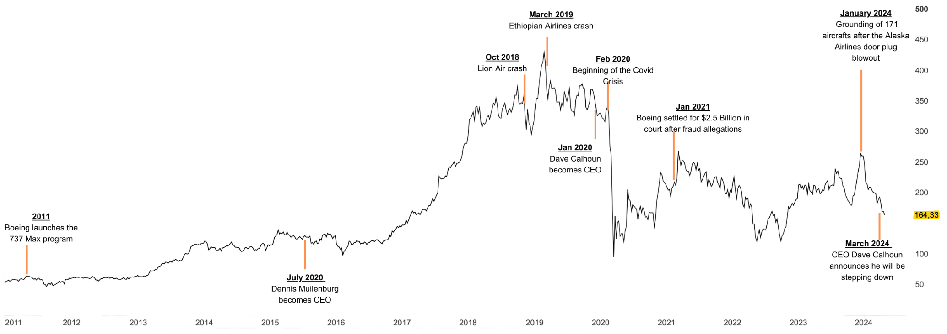
Historical Share Price Analysis
Key Events & Share Price Drivers
2011 – Boeing launches the 737 Max program
July 2020 – Dennis Muilenburg becomes CEO
Oct 2018 – Lion Air crash
March 2019 – Ethiopian Airlines crash
Jan 2020 – Dave Calhoun becomes CEO
Feb 2020– Covid Crisis
Jan 2021– Boeing settled for $2.5 Billion in court after fraud allegations
Jan 2024 – Grounding of 171 aircrafts after the Alaska Airlines door plug blowout.
March 2024 – CEO Dave Calhoun announces he will be stepping down.

Slide 15
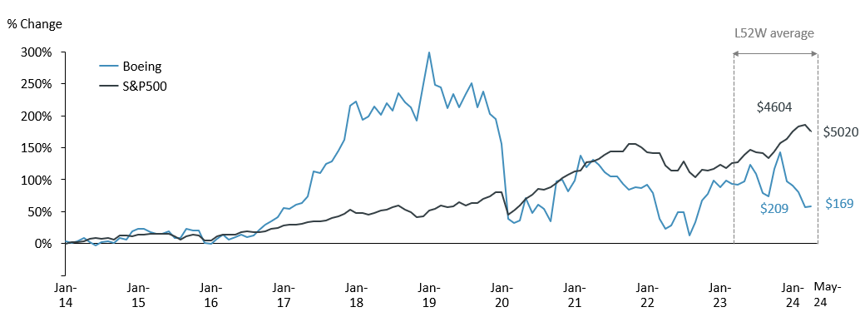
Valuation Summary
Stock Price Performance
Valuation Football Field
Relative underperformance:
YTD: While the S&P 500 is up around 6% year-to-date, BA stock is down over 32%.
3Y: BA is down roughly 25% compared to a 35% gain for the S&P 500 since 2021.
Trading near lows: BA is currently trading near its 52-week low of $150, indicating a weak sentiment.
Market sentiment:
Priced-in catalysts: The current price reflects Boeing's issues faced with the 737 MAX and expectations for increased commercial airplane deliveries in the coming years.
Loss of confidence: The stock price is not reflecting the strong Q1 revenue that beat analyst estimates. This could be due to loss in confidence and the wait for a full recovery in commercial airplane production.
$349
$300
$264
$268
$247
$231
$221
$159
$160
$140
Broker Estimates | Target Prices ($) | Upside (%) | Rating
Citigroup (25/04/2024) | $224 | +32.55% | Strong Buy
Deutsche Bank (25/04/2024) | $225 | +33.14% | Strong Buy
Barclays (22/04/2024) | $190 | +12.43% | Hold
JP Morgan (17/04/2024) | $230 | +35.78% | Strong Buy
RBC Capital (16/04/2024) | $215 | +27.23% | Buy

Slide 16
Comparables Analysis
Comparable Company Rationale
These companies operate in the aerospace and defence sector, making them direct competitors or collaborators with Boeing.
Key Similarities and Differences: All focus on aerospace/defence manufacturing and rely on government contracts. Companies like General Electric have more diversified portfolios, while TransDigm specializes in aerospace components, contrasting with Boeing's comprehensive aircraft manufacturing.
Boeing can enhance safety measures and diversify technology to regain market trust and strengthen competitiveness against industry leaders like Lockheed
Martin.
(in millions of U.S. dollars)
Stock
Equity
Firm
TEV / Revenue
TEV / EBITDA
Price / Earnings
Company
Symbol
Price
Value
Value
2021A
LTM
NTM
2025E
2021A
LTM
NTM
2025E
2021A
LTM
NTM
2025E
Northrop Grumman
NYSE:NOC
485.03
$71,977
$86,727
1.9x
2.2x
2.09x
2.11x
12.11x
18.70x
18.95x
15.38x
8.59x
14.35x
19.39x
19.64x
RTX Corporation
NYSE:RTX
101.52
$134,353
$174,652
2.4x
2.5x
2.18x
2.21x
18.30x
17.80x
14.35x
13.69x
31.8x
37.48x
18.45x
18.77x
General Electric
NYSE:GE
161.82
$174,808
$178,205
2.0x
2.6x
4.74x
4.9x
36.20x
18.40x
16.00x
22.51x
12.9x
19.38x
37.73x
39.53x
L3Harris Technologies, Inc.
NYSE:LHX
214.05
$40,164
$53,459
2.7x
EXAMPLE
2.8x
2.49x
2.52x
13.10x
14.70x
15.50x
13.93x
23.25x
17.32x
15.99x
16.33x
General Dynamics
NYSE:GD
287.09
$78,487
$88,514
1.8x
2.1x
1.85x
1.89x
13.30x
17.00x
16.70x
14.78x
17.07x
23.88x
18.74x
19.64x
Lockheed Martin
NYSE:LMT
464.93
$110,786
$127,414
1.6x
1.8x
1.81x
1.83x
12.20x
12.20x
12.30x
13.03x
14.71x
16.88x
17.42x
17.62x
TransDigm Group
NYSE:TDG
1,248.03
$69,470
$87,208
10.7x
12.5x
10.98x
11.30x
27.30x
25.40x
21.10x
21.67x
46.60x
42.92x
37.96x
39.22x
Textron Inc.
NYSE:TXT
84.59
$16,165
$18,685
1.5x
1.4x
1.27x
1.29x
13.80x
10.60x
11.40x
10.62x
23.26x
18.11x
12.85x
13.46x
Airbus SE
ENXTPA:AIR
165.2
$130,663
$127,906
1.4x
1.8x
1.62x
1.68x
21.00x
20.60x
24.40x
18.80x
21.11x
27.50x
22.66x
24.42x
Boeing Company
NYSE:BA
$167.84
$103,034
$143,438
2.6x
1.9x
1.8x
2.6x
10.5x
46.50x
23.10x
29.20x
NM
NM
NM
NM
High
$134,353
$180,526
10.7x
12.5x
10.9x
11.3x
36.2x
25.4x
24.4x
21.7x
46.6x
42.9x
37.9x
39.5x
Median
$54,999
$70,212
2.4x
2.3x
1.9x
2.2x
13.5x
18.1x
16.35x
15.0x
101.5x
21.1x
18.7x
19.6x
Mean
$62,219
$71,420
2.8x
2.9x
2.9x
3.2x
16.7x
20.2x
17.4x
17.4x
103.8x
22.9x
22.4x
23.1x
Low
$16.165
$18,685
1.4x
1.4x
1.2x
1.29x
12.1x
10.6x
11.40x
13.0x
12.9x
17.3x
12.8x
13.5x

Slide 17
DCF Model Output
Valuation Summary
Sensitivity Analysis
Terminal Value - Multiples Method
Terminal EBITDA Multiple:
WACC |  | 11.4x | 12.2x | 13.0x | 13.8x | 14.6x
 | 10.05% | $ 203 | $ 213 | $ 223 | $ 233 | $ 242
 | 9.80% | $ 208 | $ 218 | $ 228 | $ 239 | $ 249
 | 9.55% | $ 214 | $ 224 | $ 234 | $ 245 | $ 255
 | 9.30% | $ 219 | $ 230 | $ 240 | $ 251 | $ 262
 | 9.05% | $ 225 | $ 236 | $ 246 | $ 257 | $ 268
Implied Share Price from DCF
$234.34
Premium to Current Share Price
39.6%
Median TEV / EBITDA of Comps 13.5x
Implied Enterprise Value $199,322
Baseline Terminal EBITDA Multiple 13.0x
% of Implied TEV from TV 51.8%
Baseline Terminal Value $256,817
Total Debt & Capital Leases (47,940)
PV of Terminal Value $103,157
Implied Equity $143,860
Sum of PV of FCFs $96,165
Diluted Shares Outstanding 613.9M
Terminal Value – Perpetuity Growth Method
Terminal FCF Growth Rate:
WACC |  | 0.00% | 0.25% | 0.50% | 0.75% | 1.00%
 | 10.05% | $ 211 | $ 215 | $ 220 | $ 224 | $ 229
 | 9.80% | $ 220 | $ 225 | $ 230 | $235 | $ 240
 | 9.55% | $ 231 | $ 236 | $ 241 | $ 246 | $ 252
 | 9.30% | $ 241 | $ 247 | $ 252 | $ 258 | $ 264
 | 9.05% | $ 252 | $ 258 | $ 264 | $ 270 | $ 277
Implied Share Price from DCF
$240.80
Premium to Current Share Price
43.5%
Expected Long-Term GDP Growth 1.50%
Sum of PV of FCFs $96,165
Baseline Terminal FCF Growth Rate 0.50%
Implied Enterprise Value $203,280
Baseline Terminal Value $266,671
% of Implied TEV from TV 52.7%
Implied Terminal EBITDA Multiple 13.5x
Total Debt & Capital Leases (47,940)
PV of Terminal Value $266,671
Implied Equity Value $147,818
WACC Assumptions
WACC
9.55%
Cost of Equity
11.80%
Cost of Debt
5.61%
Risk Free Rate
4.69%
Equity Risk Premia
4.60%

Slide 18
Agenda
1
Company Overview
2
Investment Thesis
3
Investment Thesis
4
Valuation
5
Catalysts and Risks
6
Recommendation

Slide 19
Risk Considerations
Legend
High Risk
Medium Risk
Low Risk
Unforeseen Worldwide Events/ Global Pandemics
Heavy Dependence on Commercial Airlines
Negative perception in face of unsafe and flawed design
Dependence on performance and stability of Subcontractors, suppliers, as well as availability of skilled labour, raw materials and other components
Risks of doing business in other countries
Low Impact High
Changes in levels of U.S. government defense spending or acquisition priorities, as well as
significant delays in U.S. government appropriations
Political Instability, Inter-Governmental Tensions
Low Probability High

Slide 20
Agenda
1
Company Overview
2
Investment Thesis
3
Investment Thesis
4
Valuation
5
Catalysts and Risks
6
Recommendation

Slide 21
Price Target & Recommendation
Analyst Estimates
$140
$300
Price Target
Valuation Summary
52-Week
Range
Analysis | Price | Weight
Comparables | 221.00 | 30%
Perpetuity DCF | 240.80 | 30%
Multiple DCF | 234.30 | 30%
Street | 226.10 | 10%
Target Price | 231.45 | 100%
$160
$268
Discounted Cash Flow Mult.
$231.45
$221
$247
$140
(16.6%)
$167.80
0%
$231.45
37.9%
Discounted Cash Flow Perp.
$231
$264
Comps Rev.
The stock should be bought at below $178
$159
$349

